Slide 1
Quantitative Analyses of Urban Topography
Team 1
Denis Khryashchev
Tania Vara
Yuxiang Zhang
Yining Fan
Advisor:
Dr. Steve Koonin

Slide 2
Objectives
1. Calculate statistical characteristics of height distribution.
2. Find the intervisibility distribution for the buildings various heights. The question of intervisibility is: Can observers placed at two arbitrary points in space see each other?
3. Plot a map of intervisibility from every point for Manhattan.

Slide 3
Statistical Characteristics of Heights
 | Complete Data (feet) | Clean Data (feet)
Average pixel Height. | 67.82 | 179.94
Median | 41.59 | 153.87
Standard deviation | 93.37 | 92.91
First quartile (Q1) | 6.95 | 112.70
Third quartile (Q3) | 87.60 | 199.65
Minimum height | -210.52 | 0
Maximum height | 1340.53 | 1454

Slide 4
Can observers placed at two arbitrary points in space see each other?
Algorithm
We used Bresenham’s Line-Drawing Algorithm to determine which buildings the light of ray passed over. And we used the formula to calculate the height of ray of light

Slide 5
Can observers placed at two arbitrary points in space see each other?
Geometry and Calculations
1. We explore 2 possibilities:
A) 1st building is taller than the second,
B) 2nd building is taller than 1st.
We calculate the difference in height of the buildings. And calculate imaginary ray of light between the tops of the buildings.
2. We calculate how tall this ray is in every point. We compare the height of the ray to the height of the buildings it passes over. If it hits a building, we consider there is no intervisibility between the 1st and the 2nd building.

Slide 6
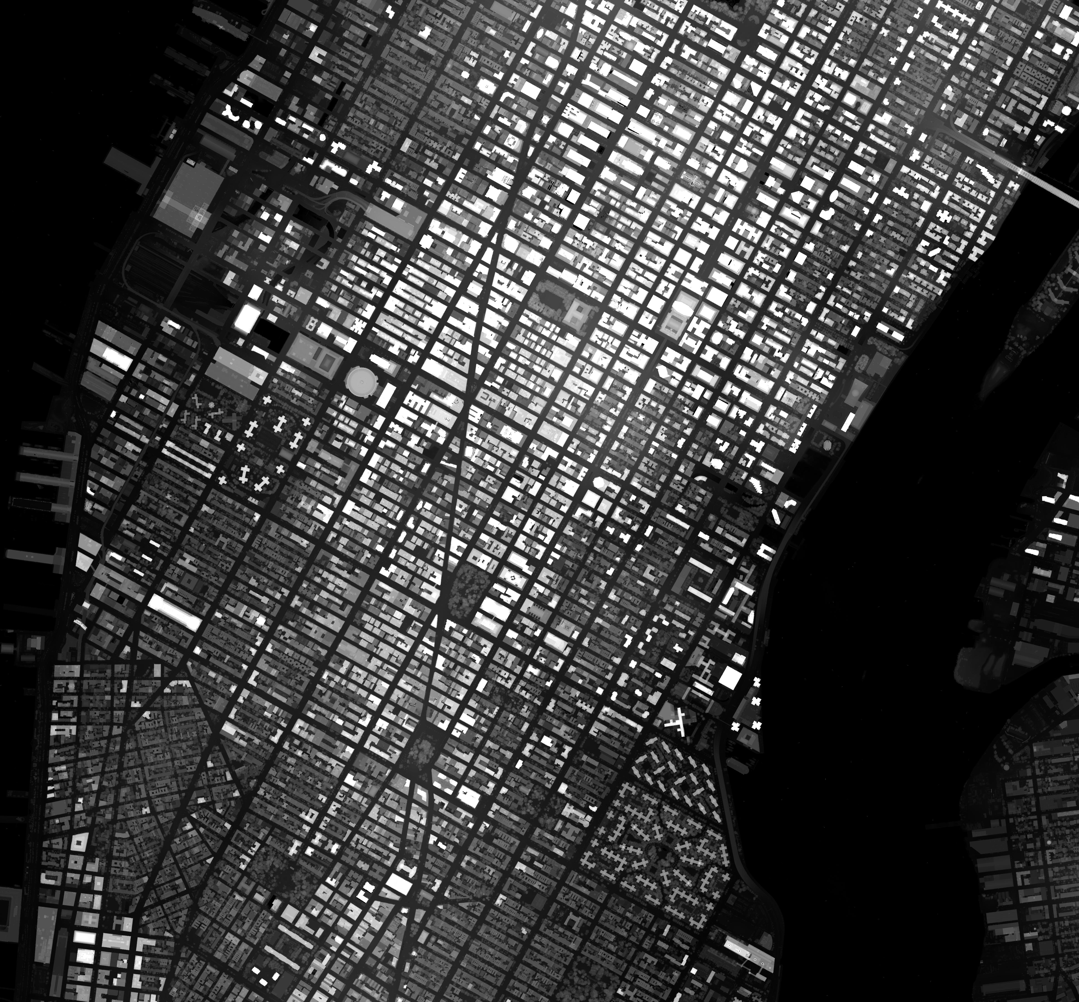
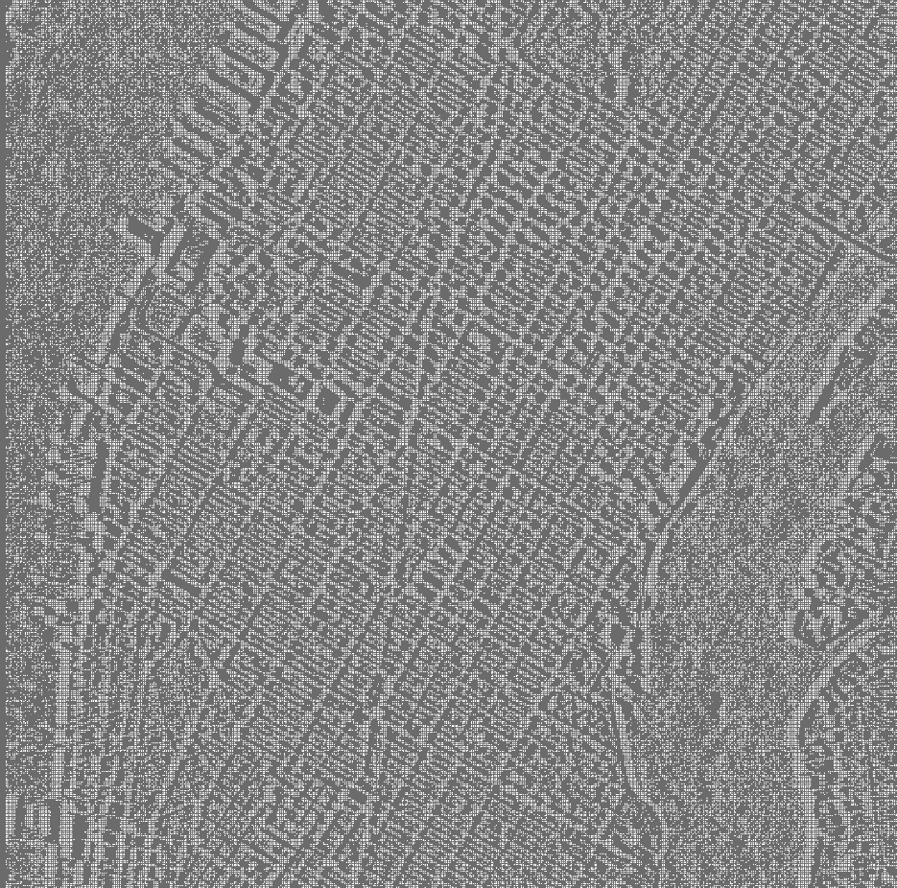
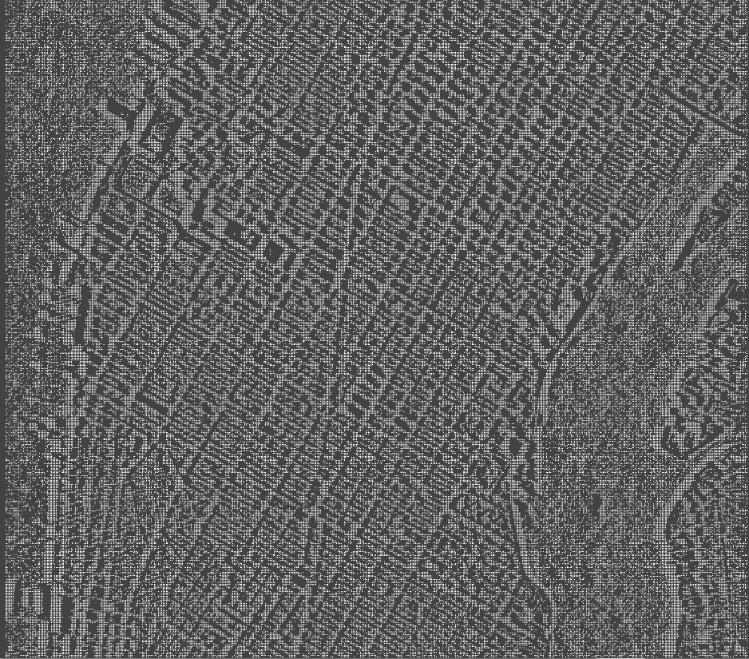
Results and Comparison
Image of Heights
Sight Image
View Score Image
Source : LIDAR Database

Slide 7
Intervisibility Calculation and Results

